Slide 1
AW OCR Design
2/20/14

Slide 2
Contents
This presentation includes:
User Requirements – input, output
Graphical user interface (GUI) – web pages
Use Cases – user actions, system responses
Data structure – container, document, page
Server components – Spring, Hibernate, AW
Runtime data flow – system behavior

Slide 3
Terminology
Workflow = Project
Box = Container
Folder = Directory

Slide 4
User Requirements
Create, Retrieve, Update, Delete (CRUD) projects, containers, documents, and pages (ocr items).
Configure ocr options per project.
Drop/Copy ocr items and wait for ocr results.
View the status of each work item
Create report (click count, total work done, etc.)

Slide 5
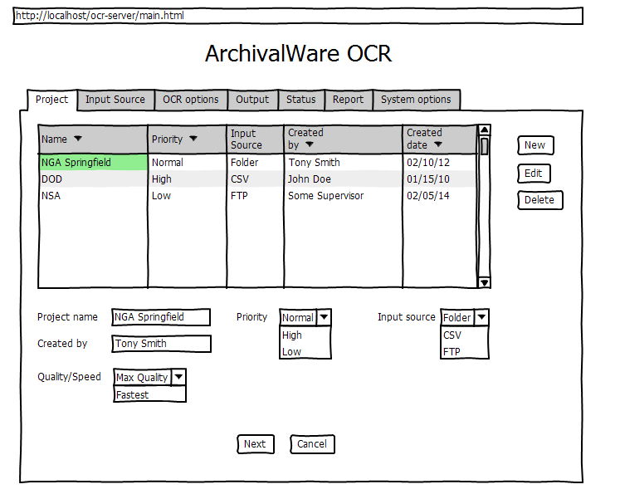
Graphical User Interface (GUI)
Set up a project, input, output, and ocr options.
Monitor progress of the work items
Create reports

Slide 6
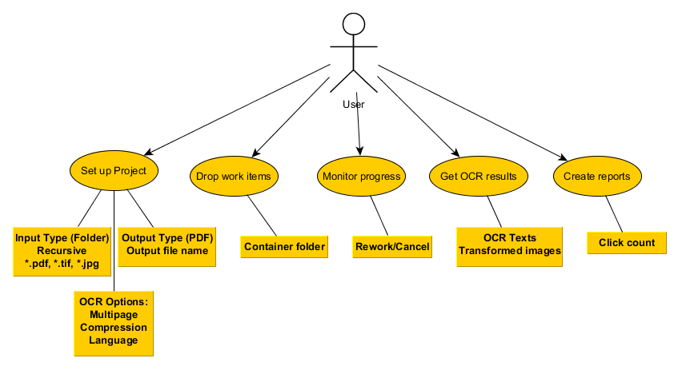
Use Cases
User may be Operator or Supervisor
Supervisor sets up a project
All users may send files to ocr and monitor them.

Slide 7
Data Structure
Database stores:
Entities and their relationships such as project, container, document, and pages.
Process input, output, and ocr parameters.
Work items queue
System parameters (thread pool, time out, etc.)
Statistics and status for report .
Data access layer with Hibernate

Slide 8
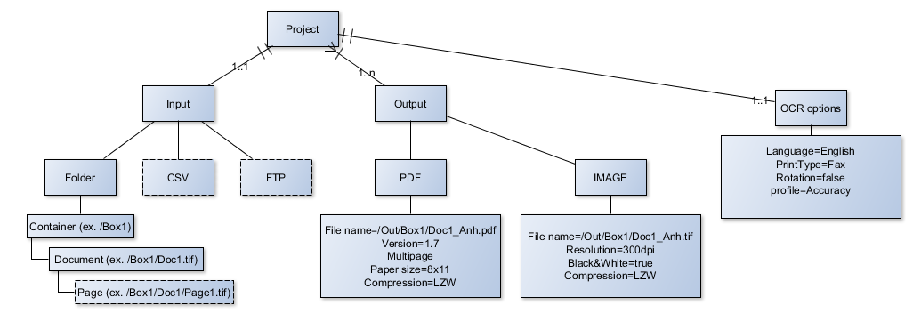
Data Structure – continue
Data entities and their relationship

Slide 9
Data Structure – continue
Database tracks runtime information such as:
Active projects
Number of tasks
Task status (Done, ocr, error)
System wait time, number of threads, etc.
User may query (SQL/HSQL) the database for click count and other statistics.

Slide 10
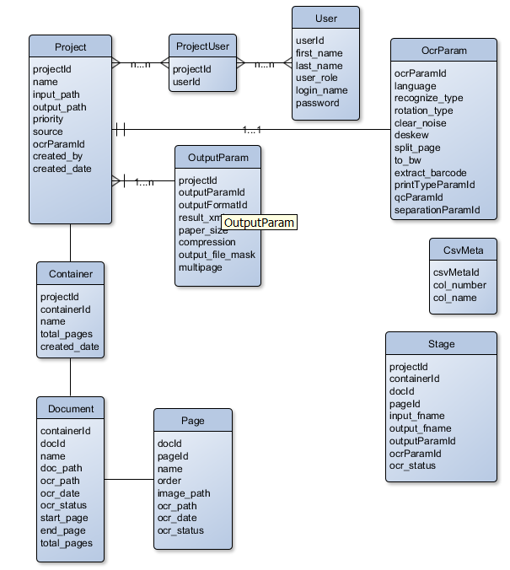
Data Structure – database (draft)

Slide 11
Server Components
A
Web Container
json
quartz
Oracle/ PostgreSQL/ hsql
Aweb
client
Aw scheduler
hibernate
http/rest
Application Container (Jboss)
Spring
Apache
ABBYY

Slide 12
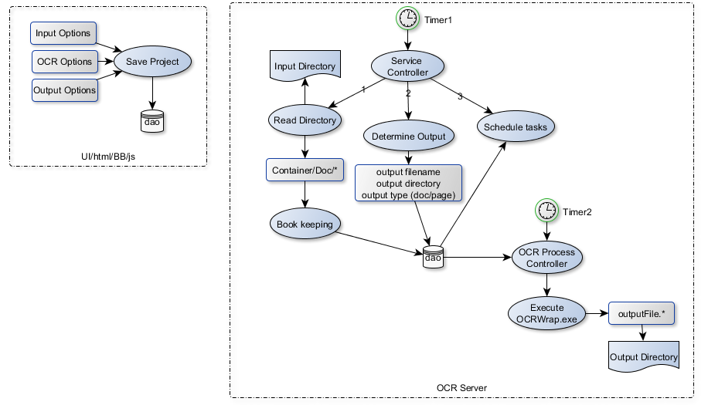
Runtime data flow – general

Slide 13
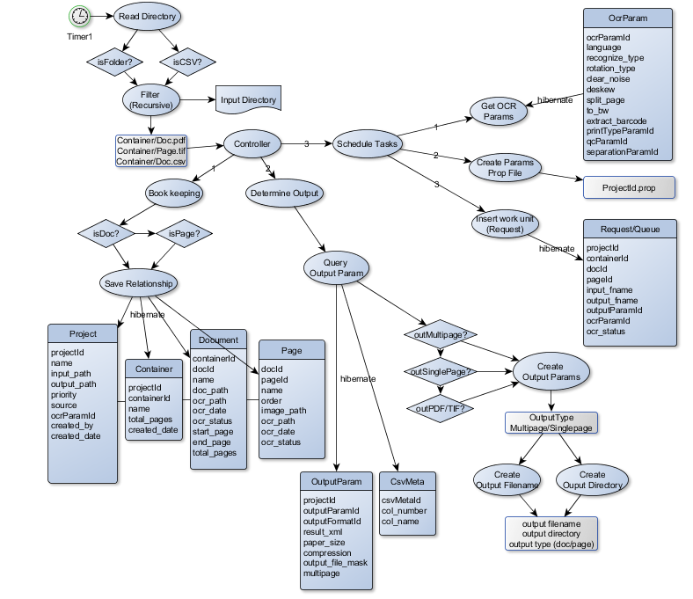
Runtime data flow – Timer 1

Slide 14
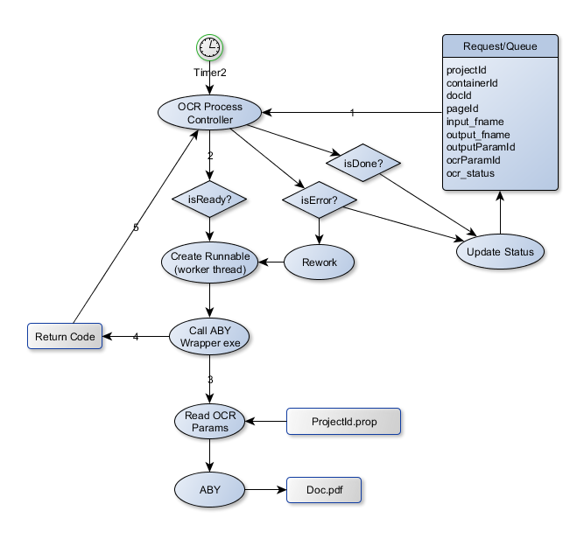
Runtime data flow – Timer 2

Slide 15
Future Enhancements
User and role
More input types (csv, ftp)
More input and output options
Input=Mutipage document, output=single pages
Input=Single pages, output=multipage document
Separate server for ABBYY

Slide 16
Benefits
RESTful web service
Multi-tiers architecture
Code reuse (GUI and server)
Configurable
HSQL, Oracle, PostgreSQL, or other database.
Easy to spin off OCR wrapper into separate server

